Slide 1
PYTHON WITH AI
Prepared by Sir Haroon

Slide 2
LECTURE 25
Exception Handling in Python
(Using try, except, else and finally)

Slide 3
EXCEPTION HANDLING
Due to an error, Python will stop the program and display error message. We should handle the error and allow the program to continue running.
An exception is an event that disturbs the normal flow of your program.
When an error occurs in your program, you inform python that the error was expected and that you are handling it. This process is known as exception handling.

Slide 4
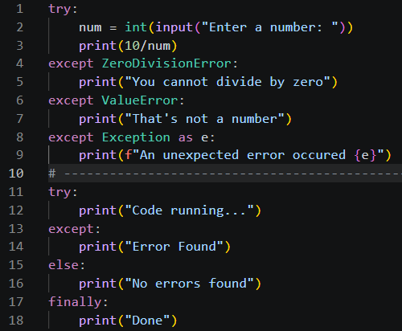
TRY, EXCEPT, ELSE AND FINALLY
Instead of showing the user a dangerous error python, we can see in this example clearly that every error is handled nicely. Else and finally will always run.

Slide 5
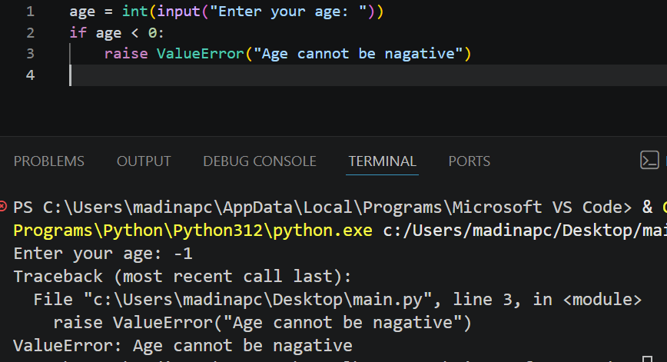
Raise exception
Process of generating an error message by yourself in your program is called raising exception. For example, when a user enters negative age, we will handle it by showing an error message.

